Slide 1
TELECOMMUNICATION CHURN PREDICTION
PRESENTED BY:
SAADHIKA YALAVARTHI

Slide 2
WHAT IS TELECOMMUNICATION?
The exchange of information over large distances refers to communication technologies that enable the transmission of data, messages, or signals between distant locations. This includes systems like telecommunication networks.
WHAT IS CHURN?
Churn refers to the rate at which customers stop using a company's products or services over a given period. It is a critical metric for businesses as high churn rates can indicate customer dissatisfaction and impact overall growth and revenue.

Slide 3
HOW TO REDUCE CHURN?
By considering the target variable as “churn”, perform analyses to generate insights that enable data-driven decisions.
Some Analysis Are……..

Slide 4
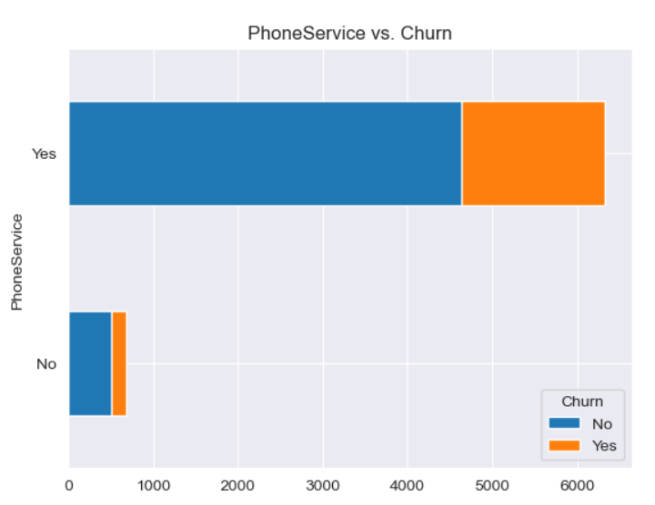
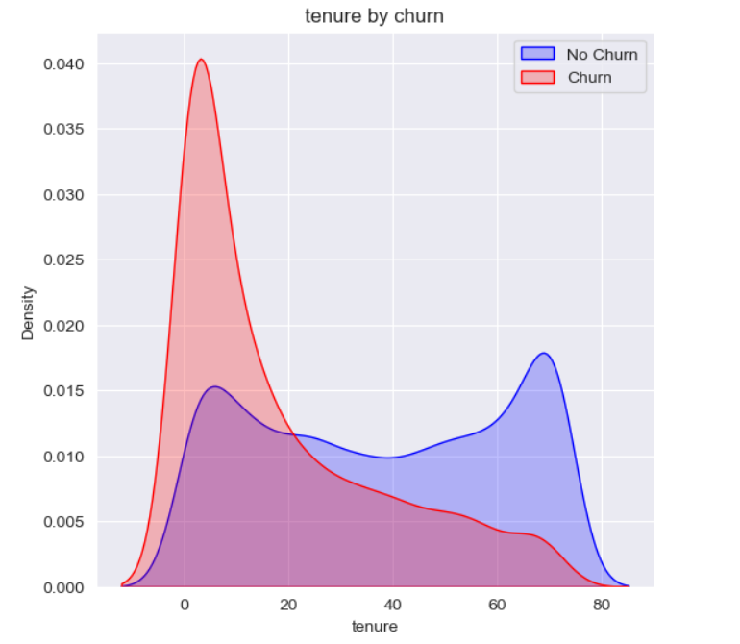
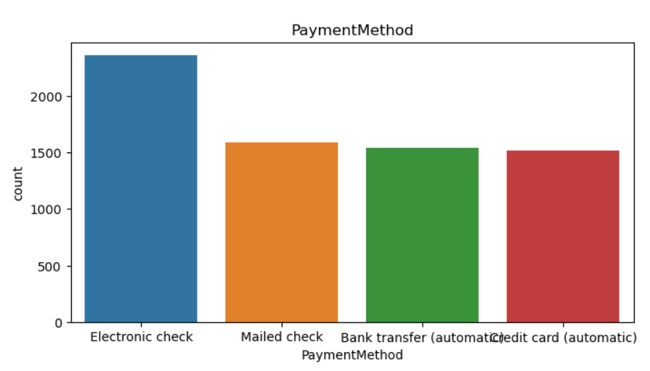
ONLINE SECURITY VS CHURN
TENURE VS CHURN
The Customer Churn Rate is high for those who is having Electronic Check Payment Method.
Lower Tenure are associated with High Churn.
The Customer Churn Rate is Higher for those who have no Online Security .
PAYMENT METHOD

Slide 5
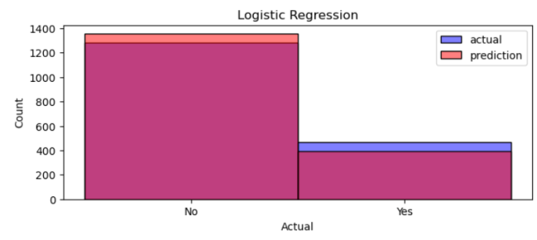
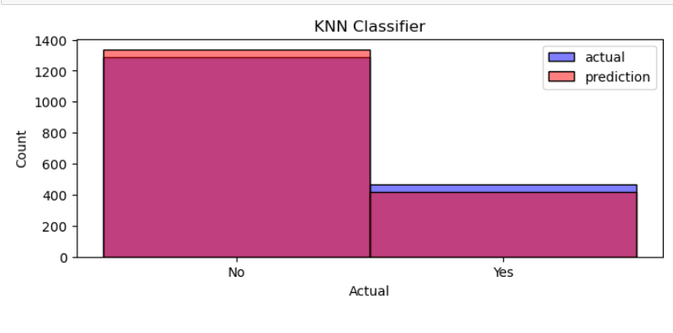
LOGISTIC REGRESSION
K-Nearest Neighbours
The histogram compares actual values (blue bars) with logistic regression predictions (red bars), showing 80% accuracy.
The histogram compares actual values (blue bars) with logistic regression predictions (red bars), showing 70% accuracy.

Slide 6
CONCLUSION
Our comprehensive model suite, including Logistic Regression (80% accuracy), KNN (75% accuracy), Decision Trees (73% accuracy), and Random Forests (78% accuracy), allowed us to detect potential churners accurately. This enabled us to execute targeted strategies that effectively reduced churn rates and increased customer satisfaction.
Thank you

